Slide 1
Eye’m Melting!
Jason Fan MD-PhD, PGY-2
Faculty Discussant: Dr. Guillermo Amescua

Slide 2
Disclosures
No relevant financial disclosures

Slide 3
Case Presentation:
A 52 year-old female presents with a chief complaint of left eye pain and redness for the past 3 weeks.

Slide 4
52yo F p/w left eye pain and redness x3 weeks…
PMH
    Childhood hearing loss
    Hypertension
    Rheumatoid Arthritis
    Recent ear infection
PSH
    Cochlear Implant
    Cesarean Section
Medications
    Atenolol
    Losartan
    Methotrexate 15mg/wk
    Prednisone 20mg qd
Allergies
    None

Slide 5
Physical Exam
 | Right (OD) | Left (OS)
Lids/Lashes | Normal | Normal
Conjunctiva/Sclera | White and quiet | Superior nodular scleritis involving the limbus, focal/superficial scleral melt (1x1mm)
Cornea | 2+ Punctate epithelial erosions | 2+ Punctate epithelial erosions
Anterior Chamber | Deep and quiet | Deep and quiet
Iris | Round and flat | Round and flat
Lens | Trace NS | Trace NS
Vitreous | Normal | Normal
Fundus Exam | Normal | Normal
VA
20/25 OD
20/25 OS
IOP
17 OD
18 OS
Pupils
3mm Dark OU
2mm Light OU
No APD

Slide 7
Questions for the Panel
What are your leading differential diagnoses?
What work-up would you propose?
What treatments would you initiate at this point?

Slide 8
Differential Diagnosis for Scleritis
Infectious
  Bacterial
  Fungal
  Viral (Herpetic)
  Acanthamoeba
  TB
  Syphilis
  Lyme
Collagen Vascular Diseases
  Rheumatoid arthritis
  SLE
  Polyarteritis nodosa
  Granulomatosis with polyangiitis
  Scleroderma
  Sarcoid
  Sjögren syndrome
  Mucous Membrane Pemphigoid
  Inflammatory Bowel Disease
Ocular Diseases
  Rosacea
  Mooren’s Ulcer
  Terrien marginal degeneration
Malignancy
  Myeloproliferative diseases
  Hodgkin disease (lymph node disease)
  Mycosis fungoides syndrome (Sézary syndrome)
Drugs
  Pamidronate disodium
Trauma or Post-surgical

Slide 9
Course of Illness
6/26/20:
CBC
CMP
RPR/FTA
Quant-Gold
ACE
ANCA
ANA
RF
HIV
6/29/20:
Lesion enlarging
Culture taken
7/1/20:
Culture repeated
7/3/20:
PR3-ANCA +
All others neg
Melt enlarging
7/11/20:
PO Cyclophosphamide 50mg
7/23/20:
Melt enlarging
Increased to Pred 80mg
Tobramycin-Dexamethasone
Aggressive lubrication
No obvious infectious foci to culture
Pred to 60mg
Moxifloxacin
Vancomycin
Polysporin Ung
Discussed with Rheum
IV Solumed if progression
MTX + Adalimumab if TB neg
IV Solumed 1g
IV Solumed 1g
Notes:
PR3 = Proteinase 3

Slide 10
Presumptive Diagnosis:
Granulomatosis with Polyangiitis (GPA)
Sinonasal disease
  Otitis Media
  Tinnitus
  Recent worsening hearing loss
Joint pain
Scleritis
PR3-ANCA

Slide 11
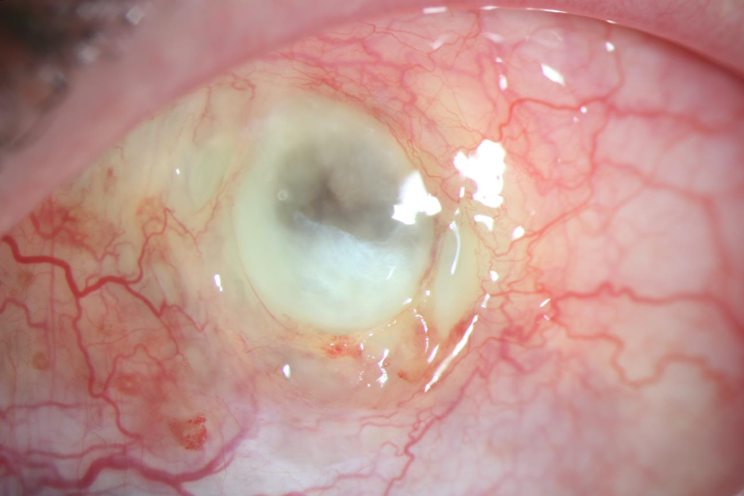
Disease Progression on Cyclophosphamide (CYC)
7/23/2020
Notes:
7/23/2020

Slide 12
Next steps:
Multidisciplinary Approach:
  IV Methylprednisolone 1000mg x3d
  Switch to Rituximab
    Hep B/C, HIV, Quant-Gold sent
  CT chest to rule out lung involvement
  UA and UPr to rule out renal involvement

Slide 13
Hospital Admission for IV Rituximab
Dr. Laura - 7/25/2020
Dr. K Fan - 7/27/2020

Slide 14
Questions for the Panel
Would you consider surgical intervention at this point?
If so, what procedure and why?

Slide 15
Corneal Patch Graft with Double AMT
Video by Dr. Neel Pasricha - 7/29/2020
Notes:
split-thickness half-moon corneal patch graft (VisionGraft). It’s Cornea that has the epithelium and endothelium removed and is then irradiated. AMG Epithelial side up to promote epithelialization. The reason I used cornea is because is easily available, is beta-irradiated (in theory offers less immunogenic response) and you can see what is happening behind the patch.

Slide 16
POD6
POW2

Slide 17
Histopathology:
Hematoxylin and eosin, original magnification x 200
Hematoxylin and eosin, original magnification x 600
Dr. Dubovy, Dr. Patel

Slide 18
Histopathology:
Gram stain, original magnification x 200
Grocott’s methenamine silver,
original magnification x 200
Acid-fast bacilli stain,
original magnification x 200
“Examination discloses conjunctiva that contains a mild to moderate acute and chronic inflammatory cell infiltrate. No organisms identified on gram, GMS, and AFB staining.”
Dr. Dubovy, Dr. Patel

Slide 19
Bascom Palmer Emergency Room: POM1
9/9/2020
Notes:
9/9/20

Slide 20
Repair of Staphyloma with Mucous Membrane Graft: POD1
Notes:
9/11/20

Slide 21
POM2
11/23/2020
Notes:
11/23

Slide 22
Further Thoughts and Discussion

Slide 23
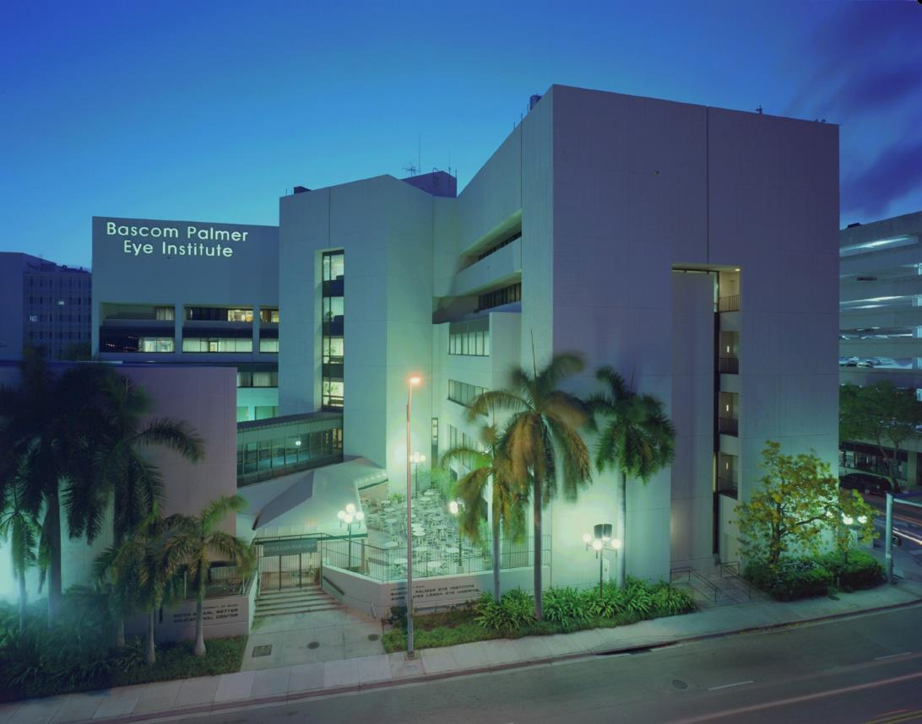
Acknowledgements
Dr. Guillermo Amescua
Dr. Neel Pasricha
Dr. Joanne Ho
Dr. Masako Chen
Dr. Aditya Kanesa-thasan
Dr. Kenneth Fan
Dr. Diana Laura
Dr. Sander Dubovy
Dr. Umangi Patel
Dr. Thomas Lazzarini
Dr. Patrick Staropoli
Dr. Jesse Sengillo

