Slide 1


ASCRS Grand Rounds
Case Presentation
Cornification & the Cornea
Zeeshan Haq, MD

Slide 2
Conflicts of Interest
No relevant financial disclosures

Slide 3
OSH Transfer Request
43 YO M with lamellar ichthyosis p/w non-healing K abrasion OD
Eye discomfort OD x 3 days a/w ↓ vision, redness, and tearing
Endorses periorbital scratching 2/2 chronic skin disease
Presented to ED today due to recent worsening over last 24 hours
High risk of poor compliance with treatment plan (unstable housing)
TRANSFER ACCEPTED

Slide 4
Additional History
PMH
Congenital lamellar ichthyosis
Last seen by dermatology in 2007
Previously treated with emollients and lactic acid
POH
Exposure keratopathy with K ulcer OS s/p lateral tarsorrhaphy
Social History
“Residential hotel” housing (homeless 1.5 years ago)
Active smoker
Crystal meth use (last 2 to 3 weeks ago)

Slide 5
CF @ 3 inches
VA_{CC}
CVF
20/60 ph 20/30
OS
OD
Round, no APD
0
0
0
0
0
0
Pupils
EOM
0
0
0
0
Round, no APD
0
0
0
0
0
0
23
External Exam:
Large, thick, hyperkeratotic plate-like scale (thickest on forehead and central face) with diffuse underlying erythroderma
IOP
19

Slide 6
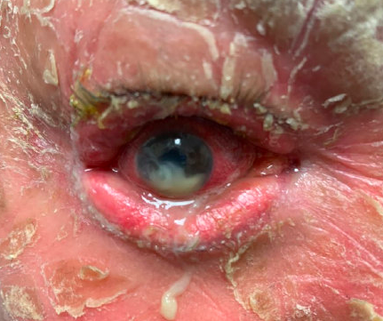
UL and LL cicatricial ectropion with margin thickening, keratinization, and madarosis
Lagophthalmos
Diffuse conjunctival injection
No corneal sensation x 4 quadrants
Inferocentral corneal ulcer with significant infiltrate and thinning (descemetocele)
Hypopyon
Hazy iris details
No view of lens, vitreous, or fundus
B-scan unremarkable

Slide 7
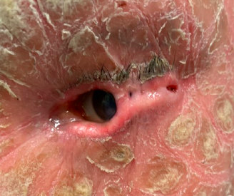
Lateral tarsorrhaphy
UL and LL cicatricial ectropion with margin thickening, keratinization, and madarosis
Poor corneal sensation x 4 quadrants
Central anterior corneal stromal scarring with inferior stromal neovascularization
Deep and quiet anterior chamber
1+ nuclear sclerosis
Poor view of vitreous or fundus
B-scan unremarkable

Slide 8
Panel Discussion

Slide 9
Exposure Keratopathy with 2˚ Infectious Keratitis with Marked Stromal Necrosis and Descemetocele
Corneal scrapings for smears (gram stain, KOH)
Corneal scrapings for cultures (blood, chocolate, potato flake)
Vancomycin and ceftazidime gtt q1hr
Atropine 1% gtt BID
Vitamin C 1 gram PO QD
Doxycycline 100 mg PO BID
Eye shield at all times
Admission to medicine service
Dermatology consult

Slide 10
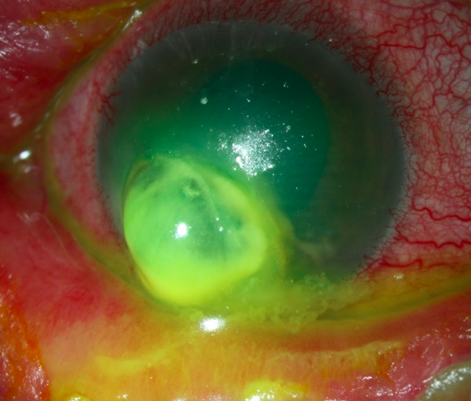
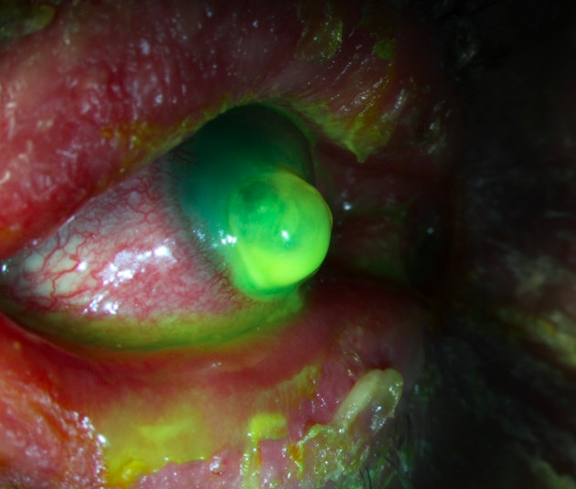
Slit lamp photographs taken on hospital day #2.

Slide 11
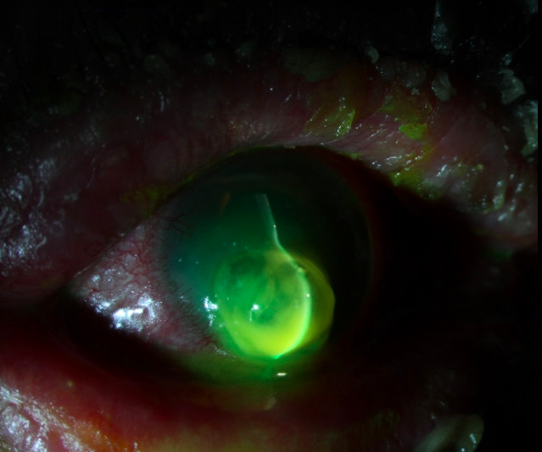
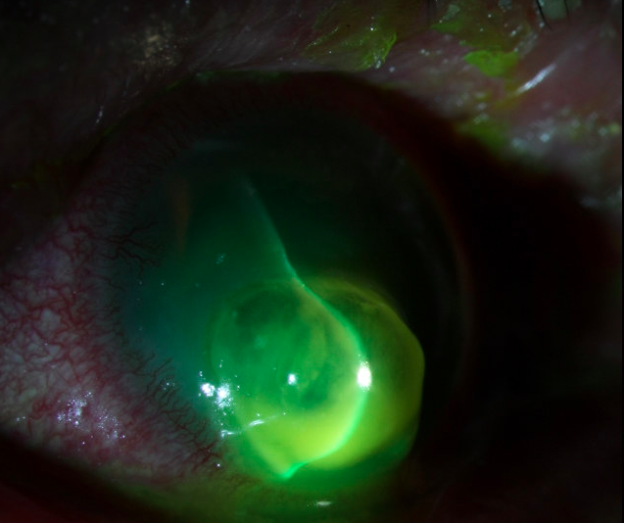
Slit lamp photographs taken on hospital day #2.

Slide 12
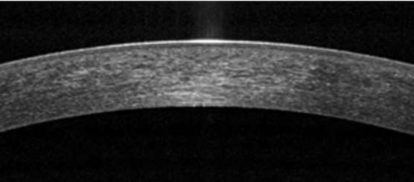
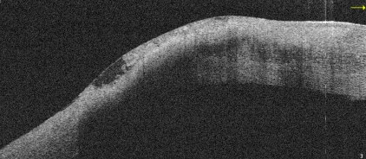
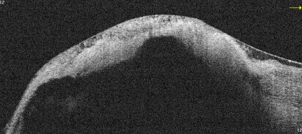
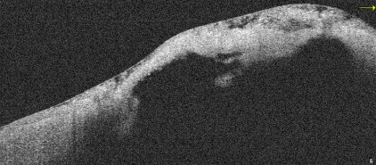
Normal
Stromal Necrosis
Infiltrate
Loss of Stroma
AS-OCT photographs taken on hospital day #2.
Reference image adapted from Venkateswaran et al. Eye and Vision. 2018;5:13.

Slide 13
Microbiology Results
HD#2
(+) Bacterial culture growth: gram positive
(-) HSV and VZV DNA
HD#3
Speciation results: group G strep, staph aureus, staph epi, and corynebacterium
HD#4
Sensitivity results: MSSA

Slide 14
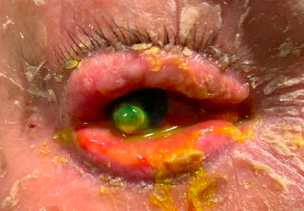
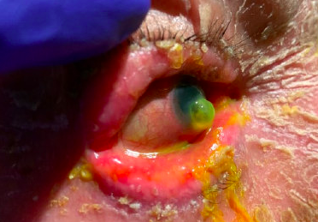
Hospital Day #4
Stable descemetocele
Improvement in hypopyon
Plan for OR intervention

Slide 15
Panel Discussion

Slide 16
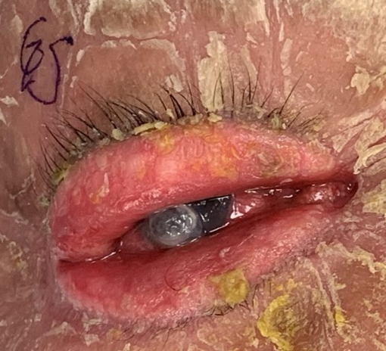
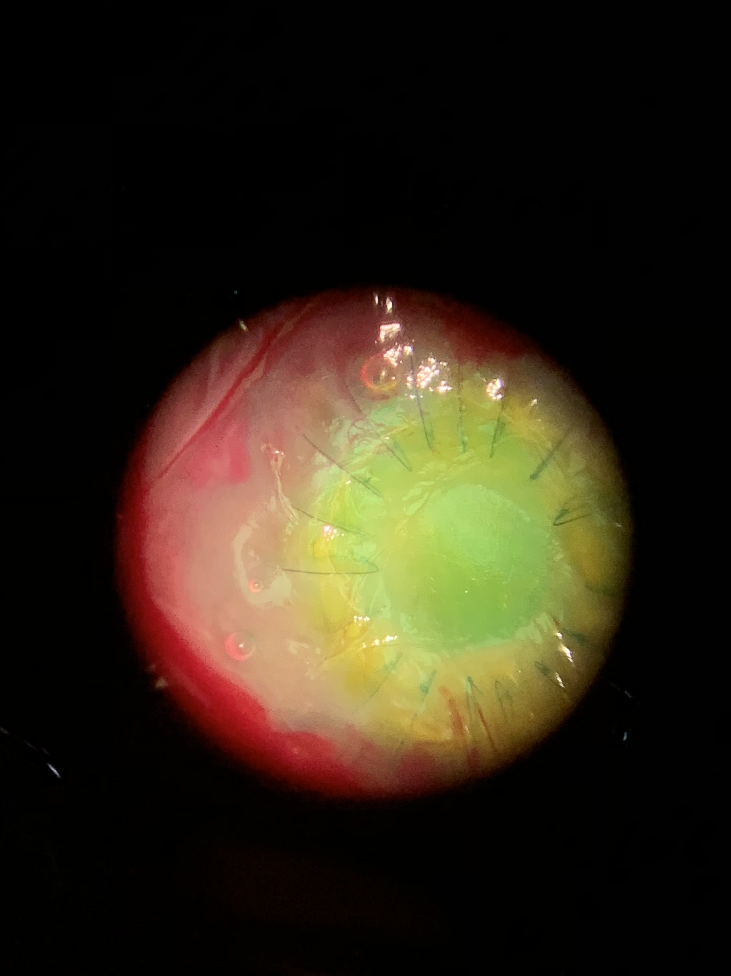
Induction
S/p TPK + AMG

Slide 17
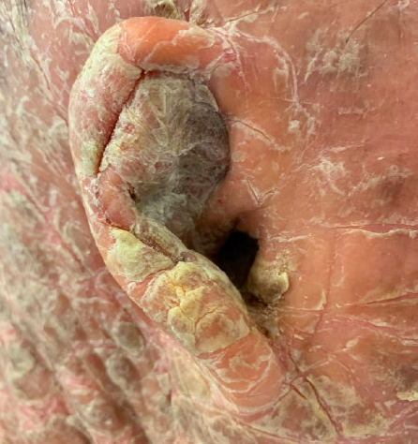
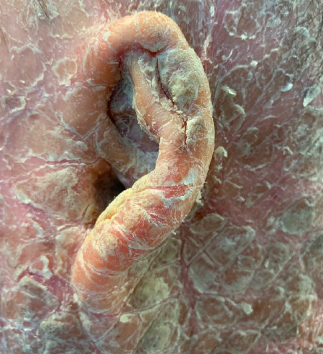
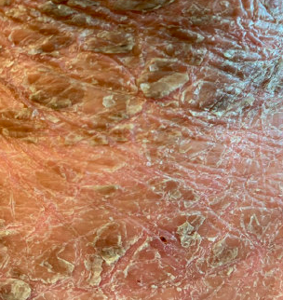
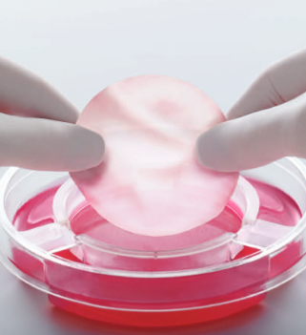
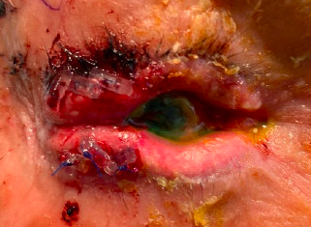
Lid Procedure
Skin Graft?
Right Ear
Left Ear
Permanent Lateral Tarsorrhaphy
Upper Chest
Synthetic Graft

Slide 18
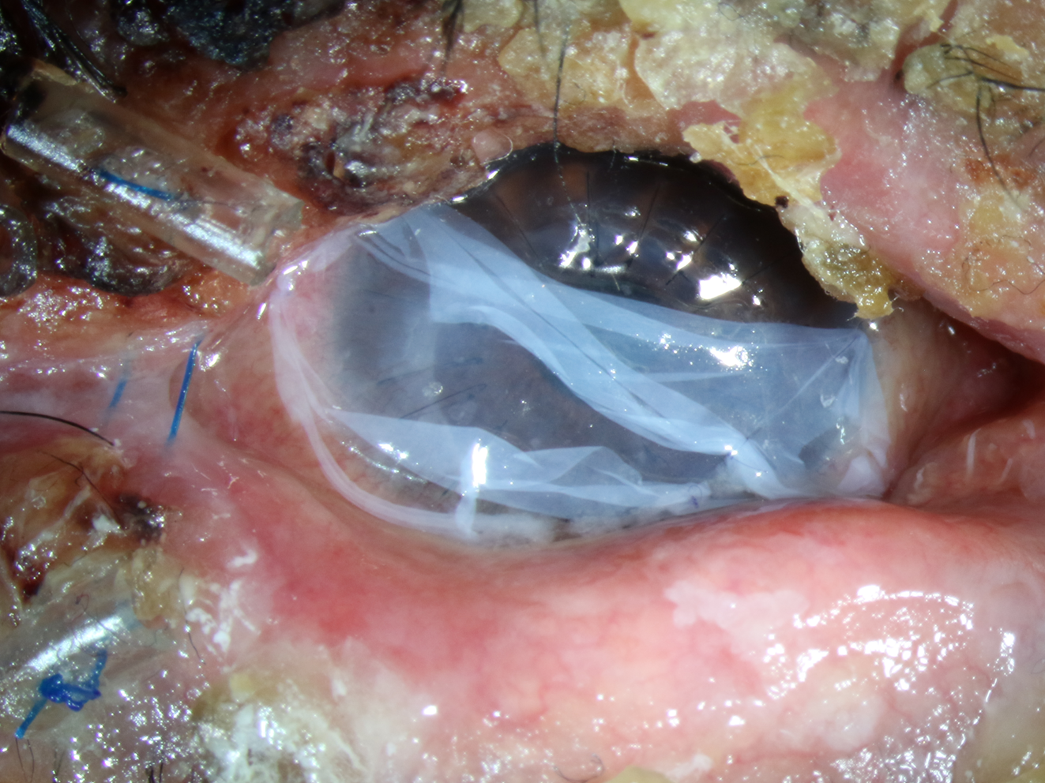
POW#2

Slide 19
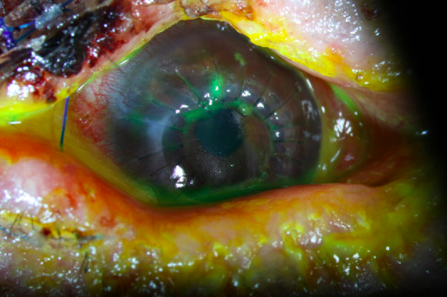
POW#4

Slide 20
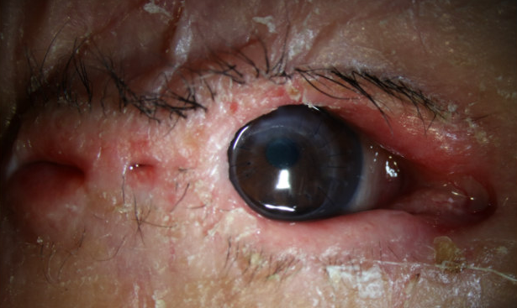
POM#18

Slide 21



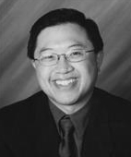




Acknowledgements
Edmund Tsui
Isaiah Giese
Quinn Wang
David Hwang
Gerami Seitzman
Michele Lee
Todd Driver
Snowy Liu
Bryan Winn

Slide 22
Panel Discussion

