Slide 1
Clarity after a bit of suffe(RING)
A case of spontaneous ring choroidal hemorrhage
Sachin Kalarn, MD
Glaucoma Fellow – Case Western Reserve University/University Hospitals
ASCRS Grand rounds

Slide 2
No financial disclosures

Slide 3
A 58yo woman with a history of multiple myeloma s/p autologous stem cell transplant 9 days prior c/b persistent vomiting was examined for right eye blurred vision and bilateral subconjunctival hemorrhage.
PMHx: CAD, aortic stenosis, bicuspid aortic valve s/p valve replacement x2 on lifelong anticoagulation
POHx: ABMD, myopia
Ocular medications: Restasis BID OU
Pertinent medications: IV Heparin, multiple stool softeners, multiple antiemetics including scopolamine patch

Slide 4
Initial examination
 | Right eye | Left eye
Vision | 20/20 | 20/20
Refraction | -4.50 sphere | -5.00 -1.00 x095
Pupils | 5mm sluggish, no RAPD by reverse | Brisk and Reactive
Color plates | 11/11 | 11/11
IOP | 50 | 16
Conjunctiva | 360 subconj hemorrhage with chemosis inferiorly | Superonasal subconj heme
Cornea | Mild Microcystic edema, ABMD | ABMD, clear
Anterior Chamber | Grade I Van Hericks, IK touch temporally and shallow centrally ~ 1.5-2 CCT | Grade 4 Van Hericks, centrally deep
Iris | Mid dilated | Round and reactive
Lens | 1+ nuclear sclerosis | 1+ nuclear sclerosis
Gonioscopy | A(slit)S – Visible ciliary processes | D40R 1+ PTM

Slide 5
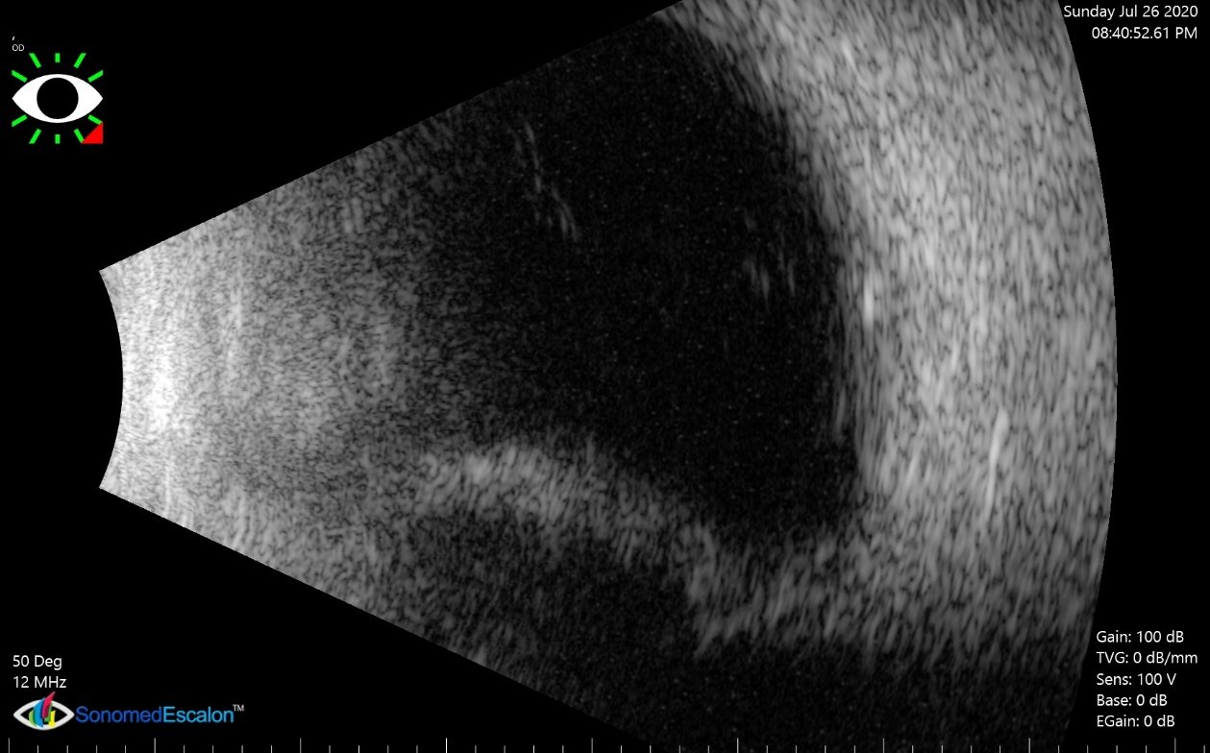
Retinal Examination
 | Right eye (undilated) | Left eye (Dilated)
Optic nerve | 0.2, pink and sharp | 0.2 pink and sharp
Macula | Flat, normal foveal reflex | Flat, normal foveal reflex
Vessels | Within normal limits | Within normal limits
Periphery | Grossly flat, difficult periphery view | Flat without holes or tears

Slide 6
Diagnosis: Acute secondary angle closure due to 360 ring choroidal hemorrhage

Slide 7
Initial therapy for right eye
Started on maximum topical therapy
  Latanoprost nightly
  Timolol/Dorzolamide BID
  Brimonidine BID
IV Diamox 500mg BID
Atropine BID
IOP reduced to 24
IV Solumedrol 250mg q6
Continue antiemetics and reduce any straining
Discussed reducing or discontinuing IV Heparin

Slide 8
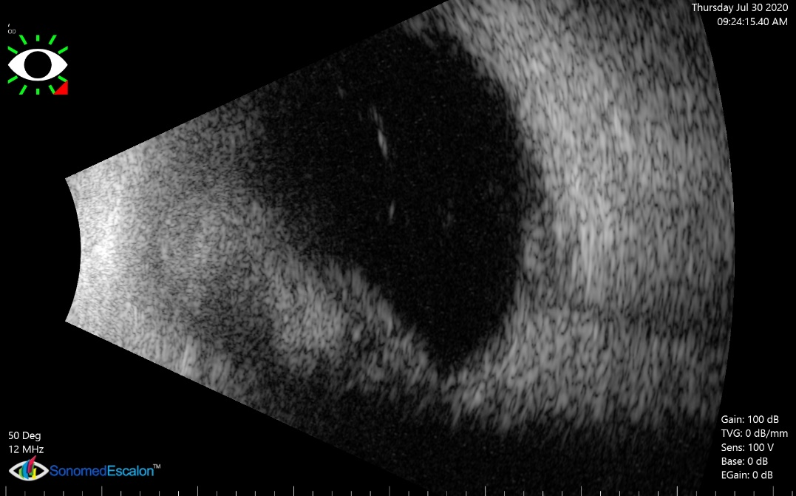
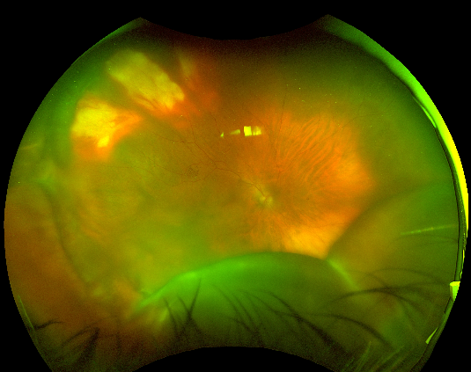
6 Days later…
Patient had vomiting episode and worsening eye pain
Vision dropped to 20/400 OD
IOP increased to > 50 OD
  Unresponsive to additional IV Diamox

Slide 9
Discussion
- Next steps for surgical intervention?

Slide 10
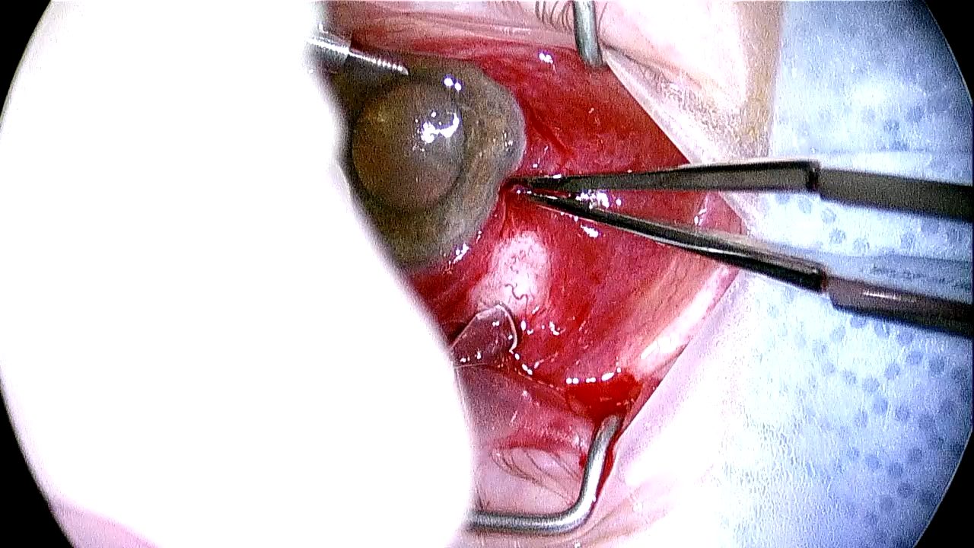

Slide 11
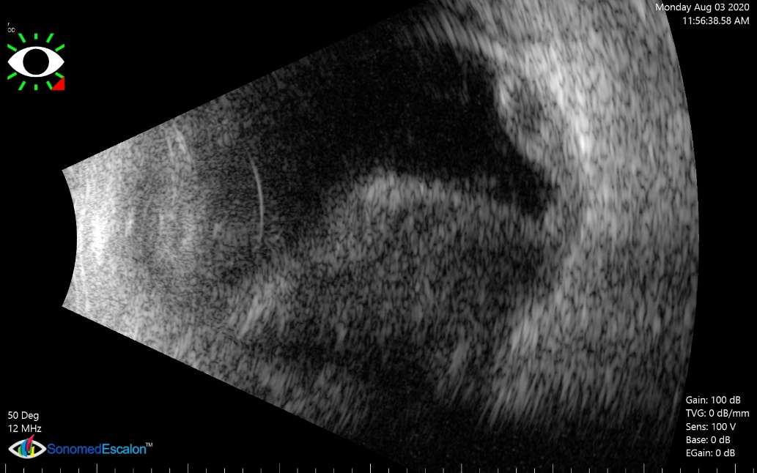
Post-operative course
POD #1 s/p choroidal drainage
  Patient had significant pain, VA - HM
  IOP remained > 50 and unresponsive to medications
Uncomplicated Ahmed FP7 Tube shunt was placed in the supratemporal quadrant
  POD #1 IOP decreased to 20, VA – 20/400
  c/b increased choroidal effusion/heme POD#2 and IOP Spike to 40 responsive to topical meds, and IV steroids

Slide 12
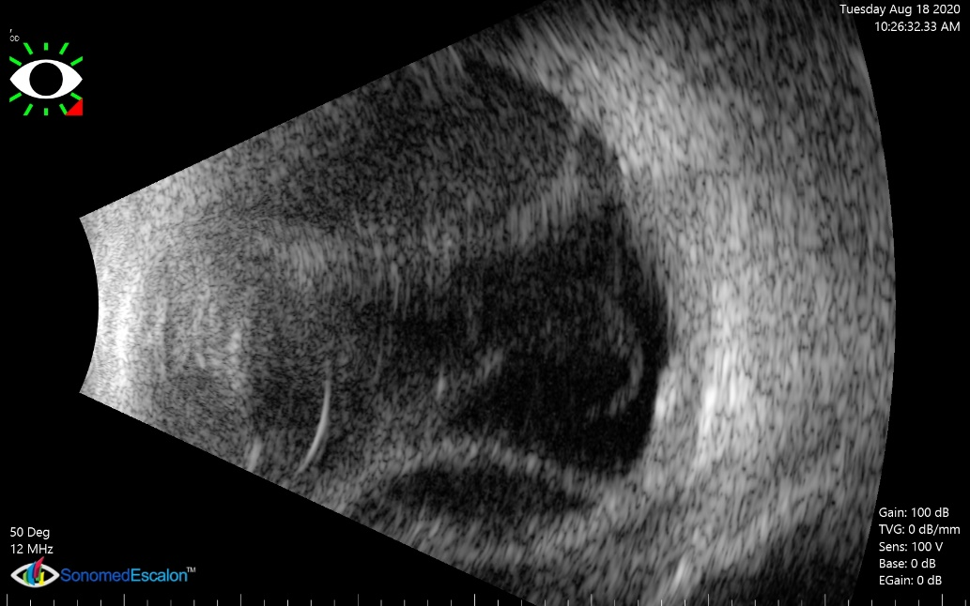
Post-operative course
Ocular status remained stable during hospital course
POD #17 s/p Ahmed Tube shunt
  IOP 9 on Dorzolamide BID
Discharged on Prednisolone QID, Atropine BID, and PO Pred 20mg daily, VA - HM

Slide 13
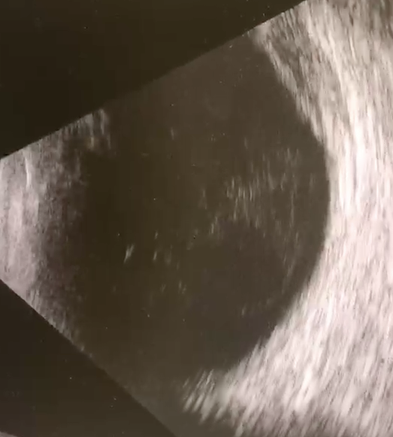
2 weeks later…
Outpatient follow up, vision declined to LP, IOP 4
Vitreous hemorrhage present
2+ Nuclear sclerotic cataract with dense PSC and heme deposition

Slide 14
Biometry was obtained for planned combined Pars Plana Vitrectomy and Cataract Surgery

Slide 15
Discussion
- Refractive and surgical planning and execution

Slide 16
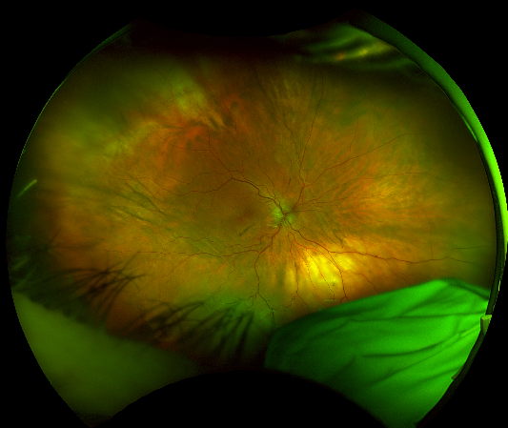
Patient underwent combined PPV/CE/IOL
18.5D Lens was placed for target of -4.50 to prevent anisometropia and suspected axial length inaccuracy
POD #1
  Vision improved to 20/400
  IOP was 1
Course was c/b persistent inferior serous detachment
Prednisolone was increased to 6x daily
POW #1
  Vision improved to 20/125, near vision 20/40 sc
  IOP 8 on no glaucoma drops

Slide 17
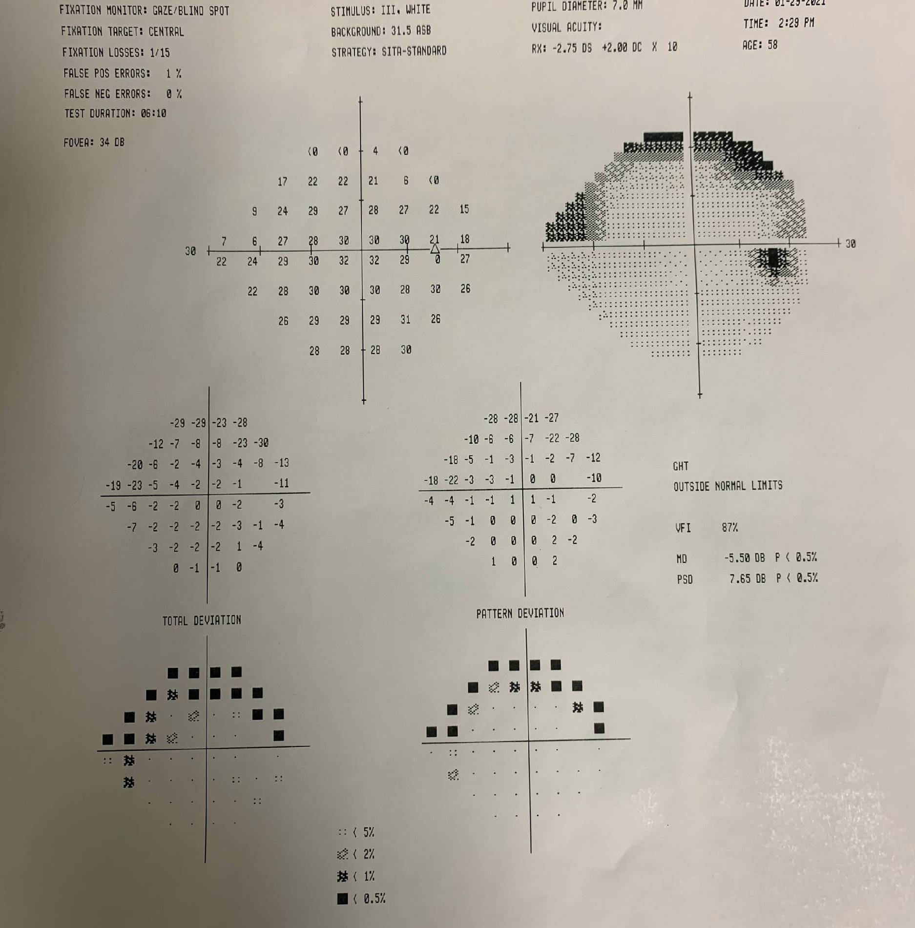
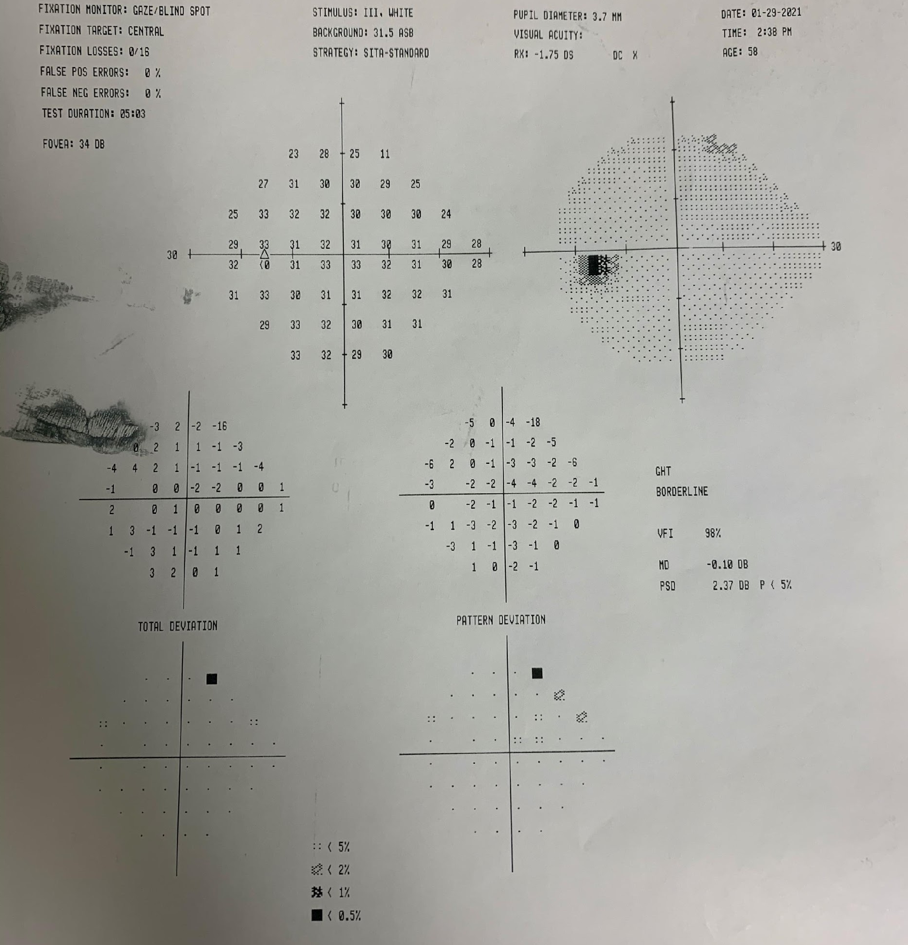
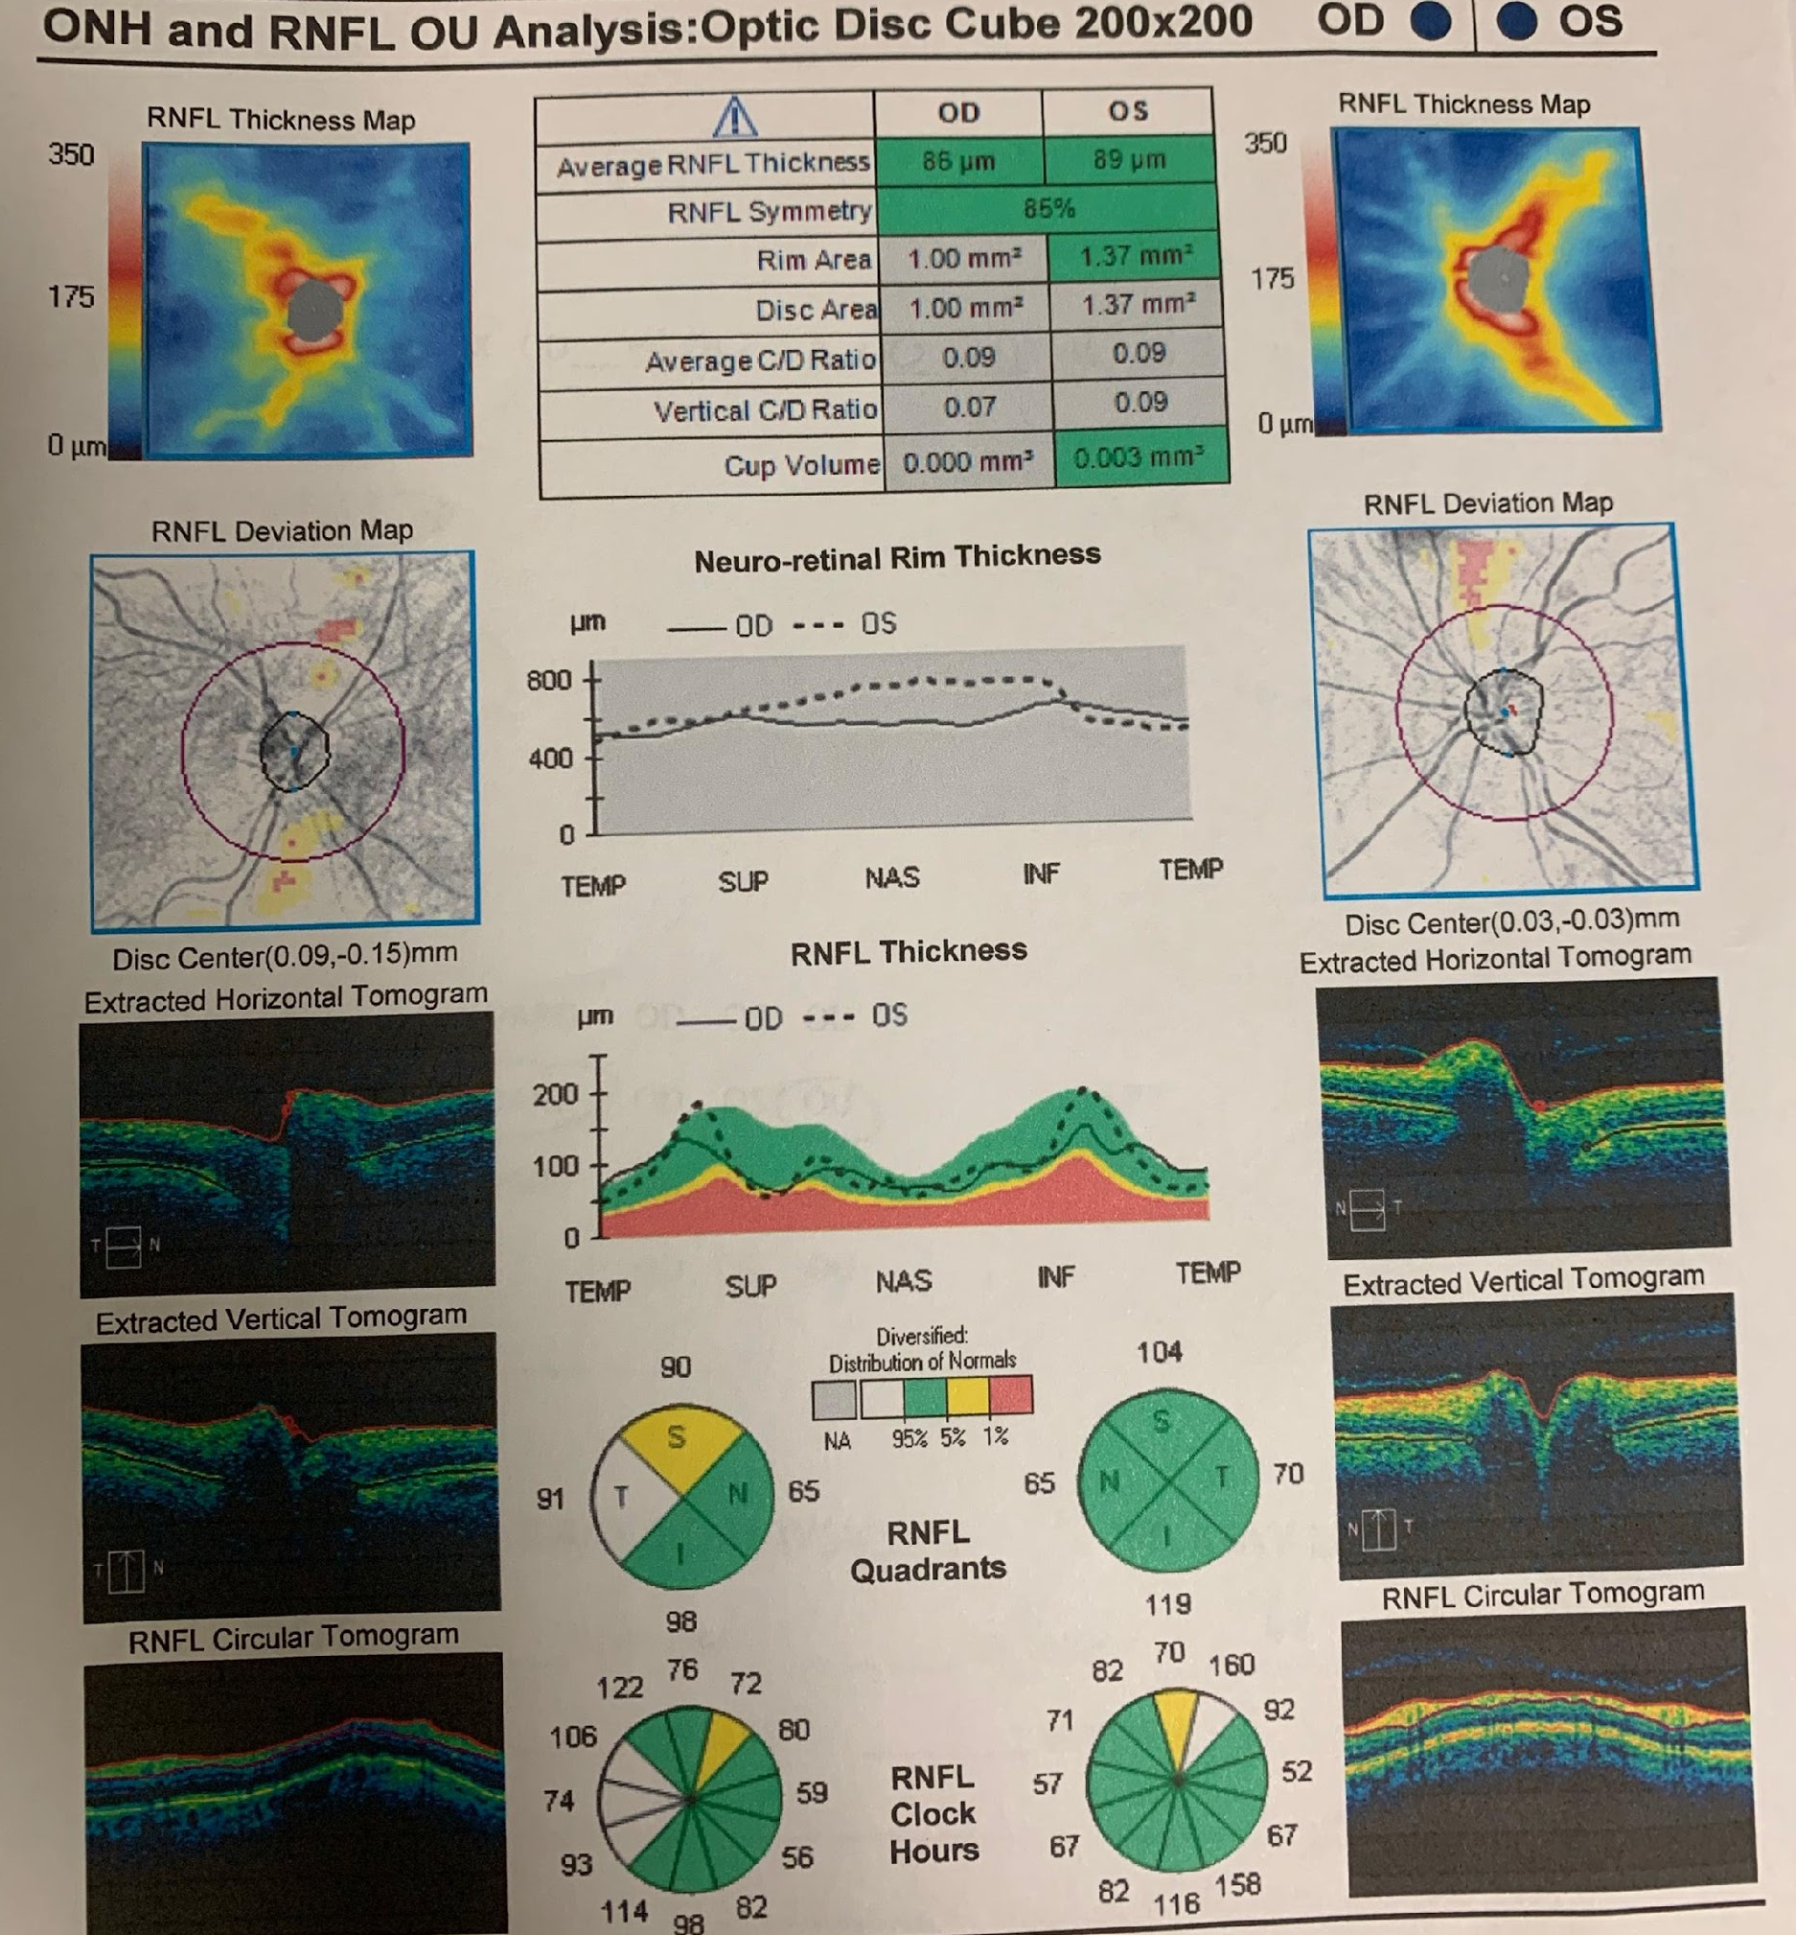
3 months later…
Vision 20/20 OU
  OD -6.00 +2.00 x 010
  OS -5.00 +0.75 x 030
IOP 18 on no glaucoma medications
Gonioscopy open OU, OD showed focal peaked PAS temporally
Down to prednisolone qdaily
Persistent inferior serous detachment to the arcade
Pending further laser barricade vs surgical drainage

Slide 18
Thank you to residents and faculty
Dr. Yasmin Sozeri, MD
Dr. Warren Sobol, MD
Dr. Lily Kim, MD
Dr. Roy Swanson, MD
Dr. Lalita Gupta, MD
Dr. Etienne Schonbach, MD

