Slide 1
The Good,
  the Bag,
              and the UGHly
Lily Hipp, PGY-3
Case Western Reserve Ophthalmology

Slide 2
  Financial Disclosures
None

Slide 3
Initial Presentation
An 85-year old woman presents as referral to the glaucoma service from optometry for 6-8 weeks of intermittent vision loss, documented at prior visit to be CF at 1ft OD with IOP of 27 mmHg OD.

Slide 4
History
Ocular history: cataract surgery OU at an outside hospital “at least ten years ago”, uncomplicated to her knowledge
Medications: simvastatin, donezepil, timolol maleate 0.5%, prescribed BID by optometry but taken sporadically due to patient’s dementia. Notably no history of blood thinners.
No history of trauma, prolonged steroid use, family history of eye disease or blindness.

Slide 5
Initial Examination
 | OD | OS
Vision (corrected) | 20/25-2 | 20/25+
Pupils | PERRL/no APD | PERRL/no APD
IOP | 21 mmHg | 16mmHg
EOMs | Full | Full
Visual fields | Full | Full
Pachymetry | 635 mm | 578 mm
Notes:
Interestingly, though she had poor vision weeks ago, it is better today.

Slide 6
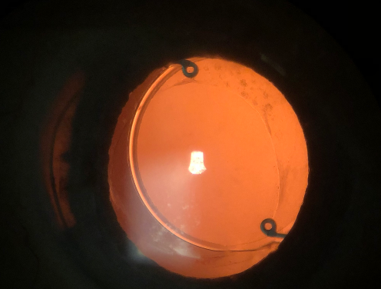

Slide 7
Questions for the Panel
What are your leading differential diagnoses?
What imaging modalities would you use, if any, to elucidate the anatomy?
Is there any role for medical therapy? When would you start thinking about surgery?

Slide 8
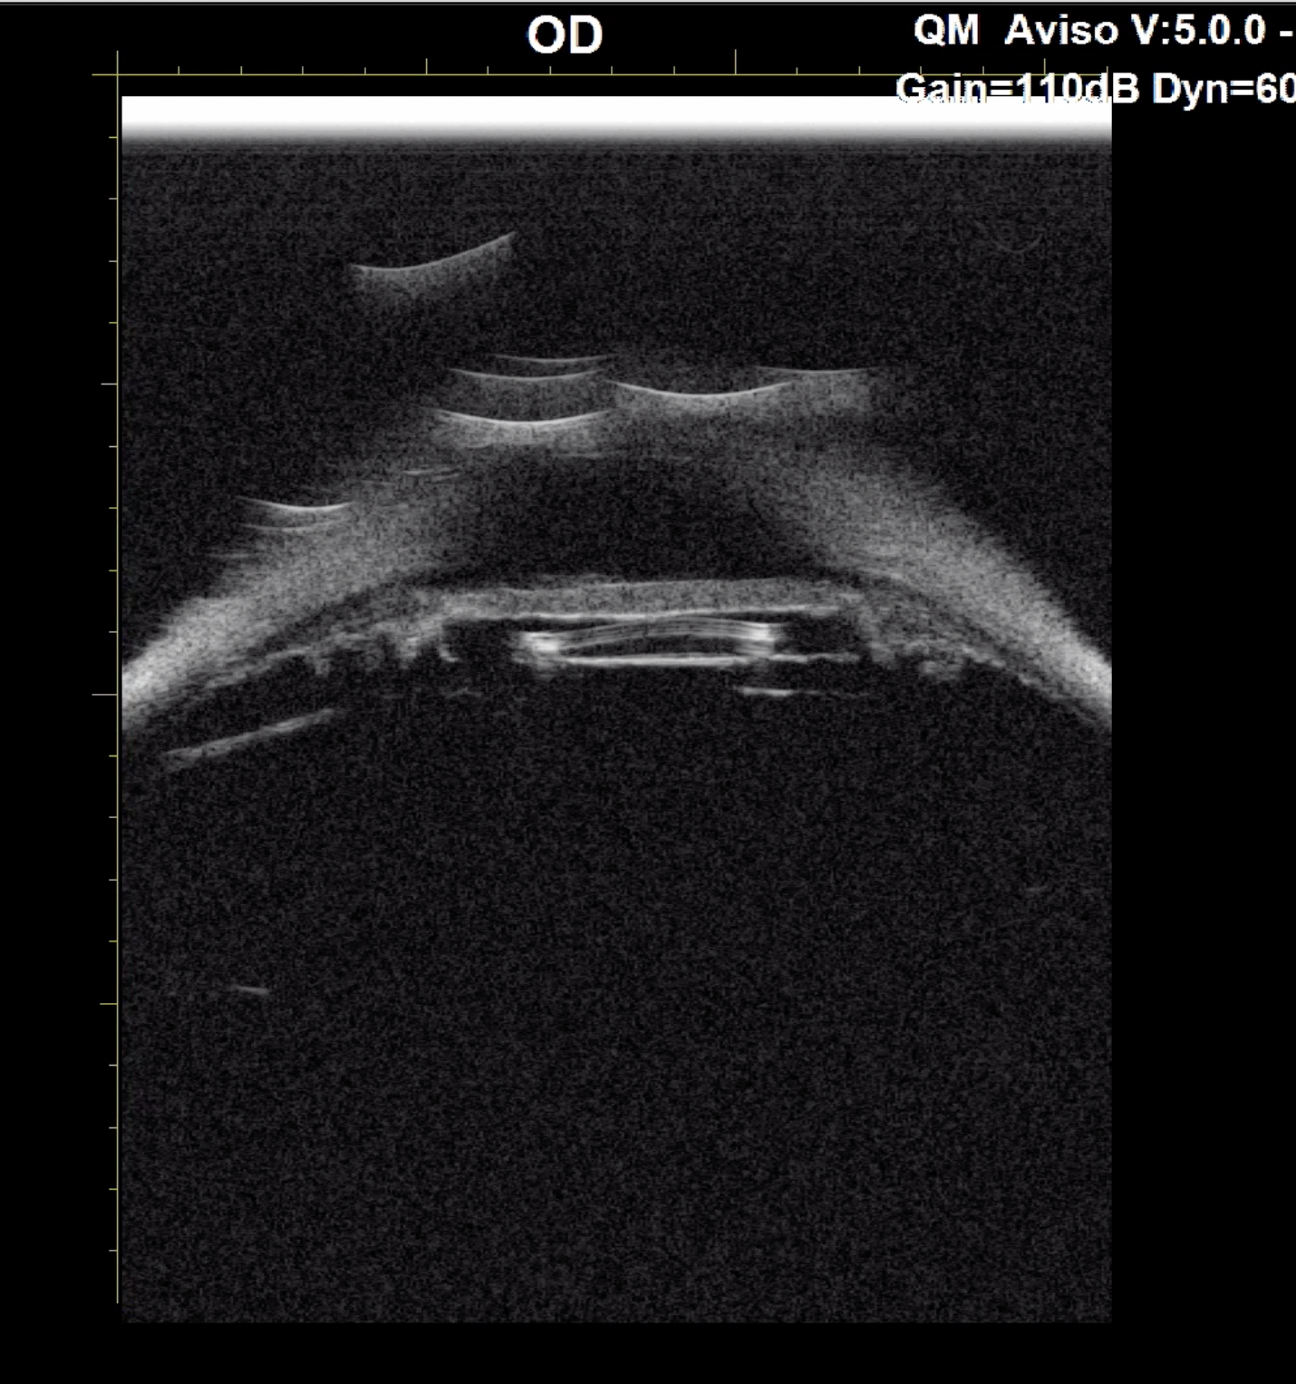

Slide 9
Follow Up One Month Later
Continued timolol BID OD
OD: BCVA 20/25-2, IOP 20 mmHg, 4+ circulating pigment in AC and stable iris TID

Slide 10
Question for the Panel
What would be your approach with surgical planning?

Slide 11
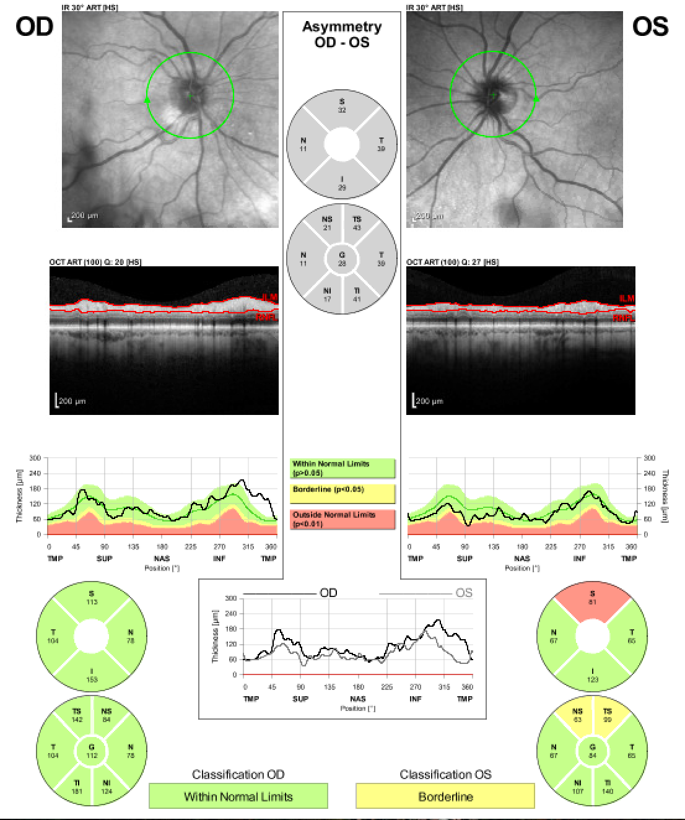

Slide 12
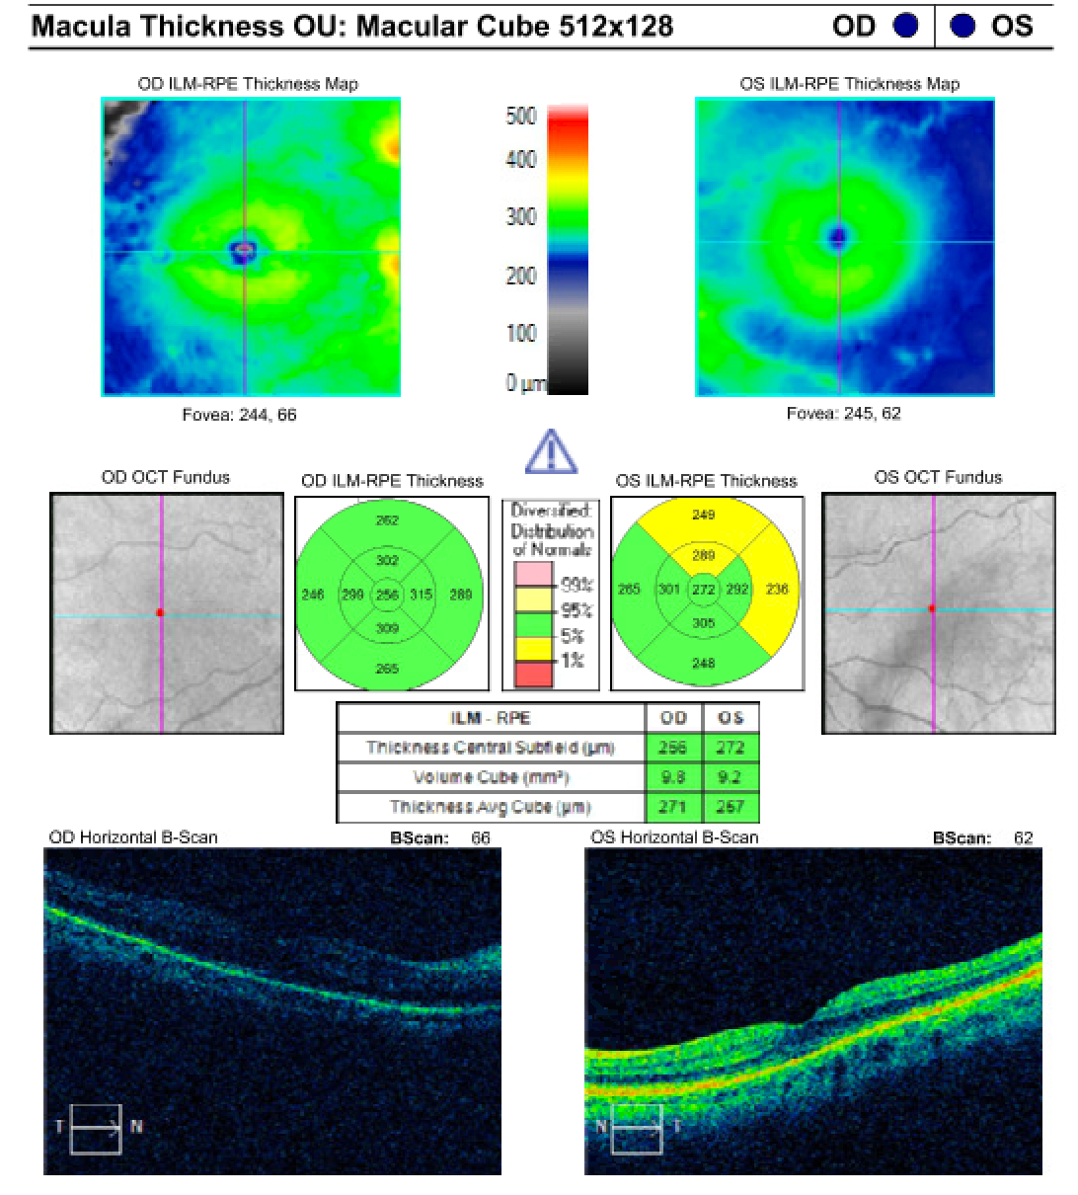

Slide 13
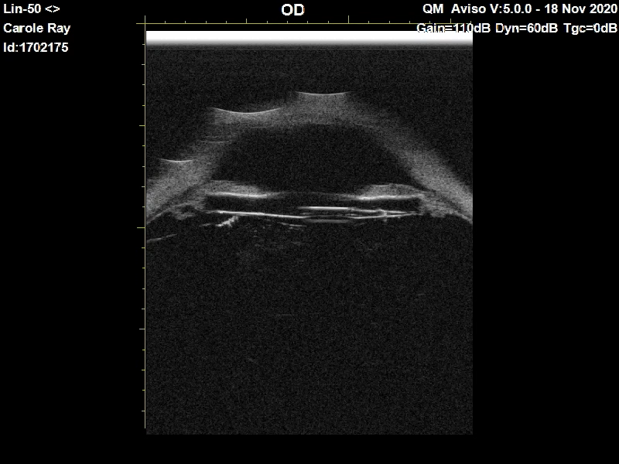

Slide 14
Further Thoughts or Discussion?

Slide 15
Follow Up POD#1
20/50+, 1+ cell, haptics in bag.
Moxifloxacin QID OD until follow up in 2 weeks
Missed POW1 appointment 2/2 COVID and snowstorms
To be continued…

Slide 16
  Special Thanks
Dr. Shakeel Shareef and Dr. Faruk Orge

