Slide 1
Sudden Vision Loss, Years after Refractive Surgery
Mike Murri MD PGY3
Eric Weinlander MD
Amy Lin MD
ASCRS Grand Rounds

Slide 2
No financial Disclosures

Slide 3
history
Chief Complaint: Right eye pain and blurry vision
30 year old male who presented initially after waking with OD eye pain, blurry vision, eye redness, photophobia, and monocular diplopia. History of phakic IOL OU 12 years ago with post-operative enhancement OD. Patient reports there were "issues" with OD surgery.
PMH: ADHD on Adderall XR 30 mg q24h
No recent trauma

Slide 4
exam
Visual acuity: 20/30 OD 20/70 PH 20/25 OS
Pupils: 5 -> 3 mm OU
IOP: 6 mm Hg OD 11 mm Hg OS
Visual Fields: Full to confrontation OU
Manifest Refraction: Unable/NI OD -1.25 OS 20/20

Slide 5
Slit lamp EXAM
OD: Verisyse lens with superior claw disengagement from iris with dislocation of lens nasally, optic edge bisecting visual axis
No AC cell, + debris on endothelium nasally. No lens-cornea touch.
OS: Verisyse lens in good position
Superonasal iridectomy with numerous TIDs OU
Otherwise anterior segment and dilated fundus exam normal OU

Slide 6
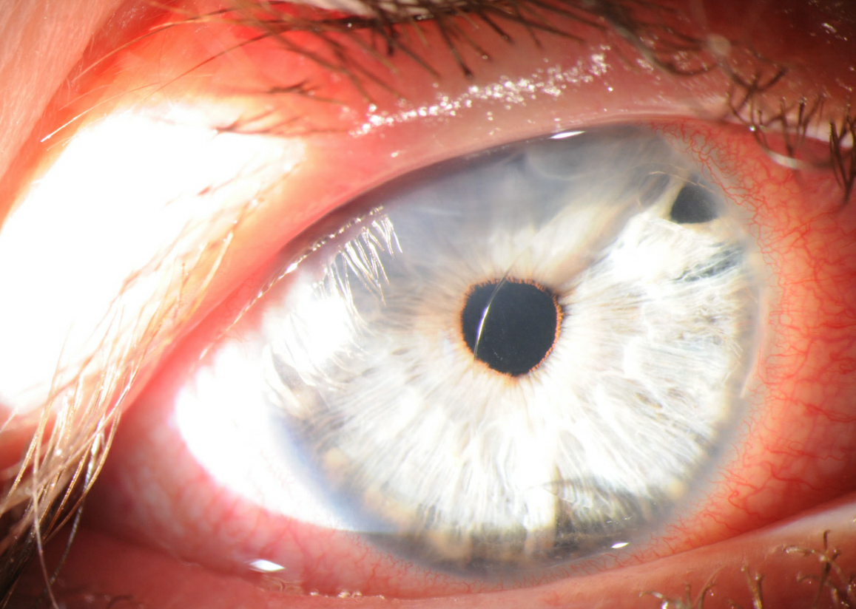
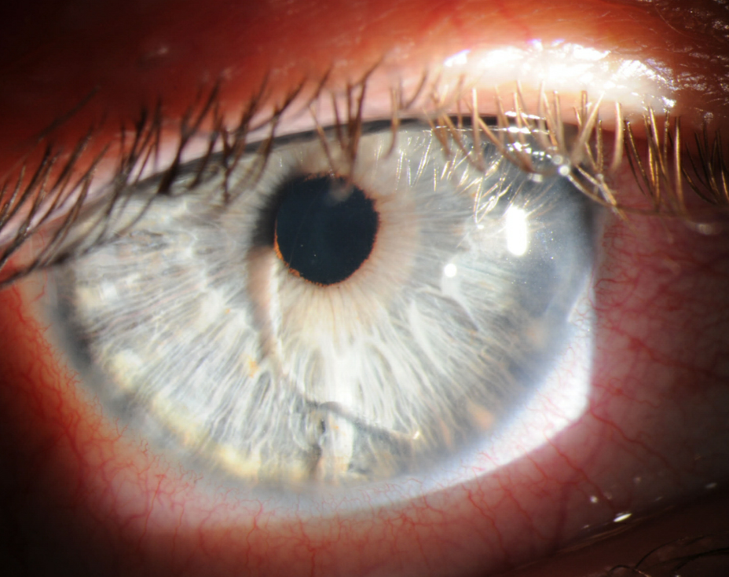
Photos OD
Notes:
OD: Verisyse lens with superior claw disengagement from iris with dislocation of lens nasally, optic edge bisecting visual axis
No AC cell, + debris on endothelium nasally. No lens-cornea touch

Slide 7
Discussion Questions
  What are treatment options?
  What are possible reasons for the dislocation?
  Have you seen this before?

Slide 8
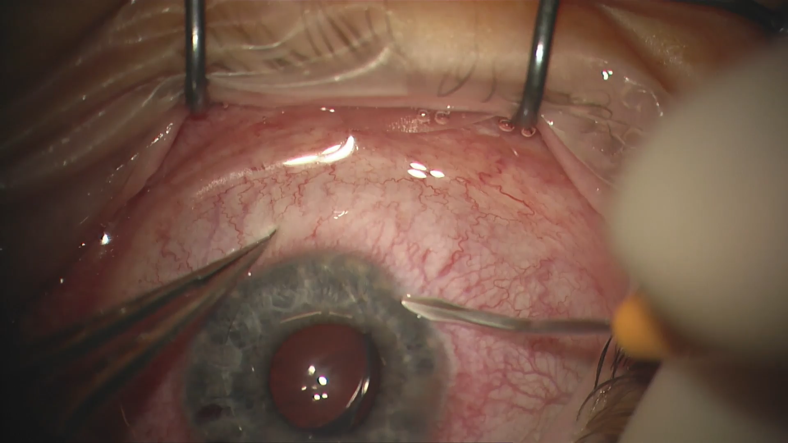
Surgical Video
Notes:
Verisyse lens was noted to be enclavated inferiorly and loose superiorly. Two paracenteses were made inferiorly with a paracentesis blade. The anterior chamber was filled with Healon. Iris was disenclavated inferiorly using a Sinskey hook and a micrograsper. The Verisyse lens was then moving freely.
A 6.0 mm superior groove was created with a diamond blade set to 380 microns. A crescent blade was used to tunnel into the cornea along the entire length of the groove. Then a keratome was used to enter the anterior chamber and open the wound. The Verisyse lens was maneuvered into the wound with a Sinskey hook and the wound was noted to be tight. The wound was enlarged with a keratome. The lens was then delivered from the eye.
The superior wound was closed with three interrupted 10-0 nylon sutures. The viscoelastic was washed from the eye. The sutures were rotated and buried. The paracenteses were hydrated. All wounds were checked and found to be water-tight. The eye was of physiologic pressure.

Slide 9
Early Post op Course
POD1: Visual Acuity 20/30 OD with -18.00 loose lens refraction, IOP wnl
On prednisolone acetate qid and moxifloxacin qid OD (tapered over next few weeks)
POM1: 2 of 3 sutures removed

Slide 10
Discussion
Would anyone re-enclavate the existing Verisyse implant instead of explanting?
What are possible ways to manage the patient long-term after Verisyse explant (ICL, clear lens extraction, or CL)
How should the residual refractive error in patient's other eye be managed (glasses/CL, PRK or LASIK if corneal topo and thickness ok)?

Slide 11
Post operative course
POM2:
  Final suture removed
  Cornea clear
  Endothelial cell count 2639, but more polymorphism and polymegathism OD
  Referred to optometry for CL

Slide 12
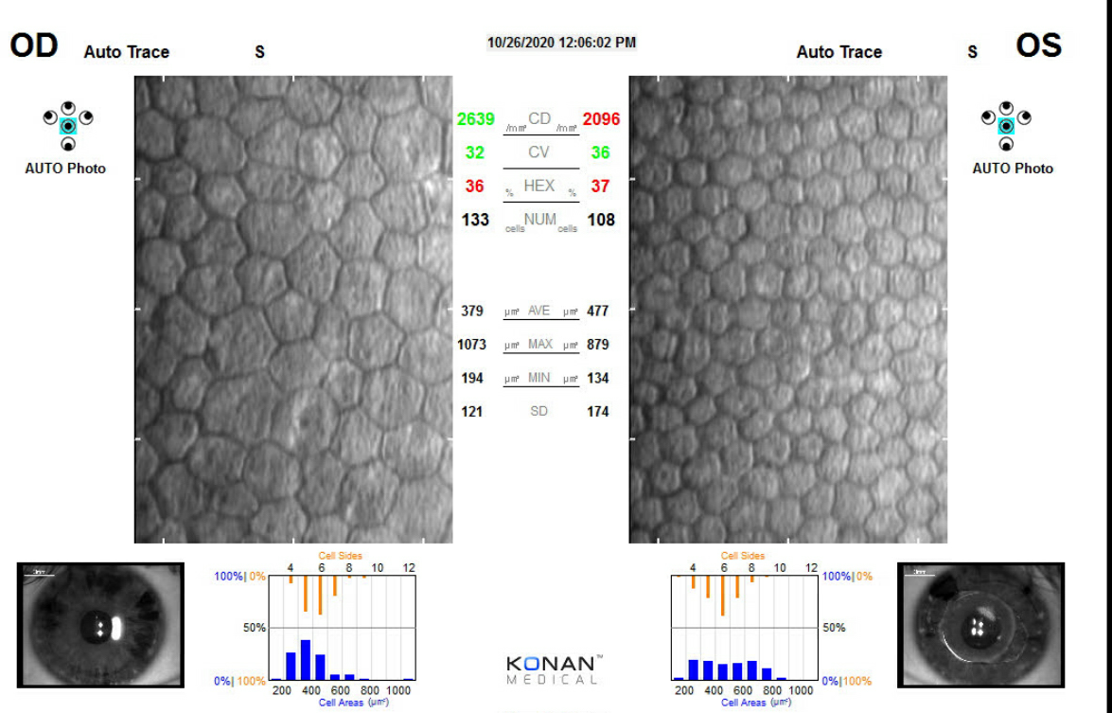

Slide 13
Post operative course
POM3:
  Final Rx
    OD -16.50 +1.25 x 010 20/20
    OS -1.25 20/20
  Fitted for CTL, waiting on delivery
Plan for return at POM6 for refractive screening visit including topography and Pentacam OU

